Slide 1
Inference in Regression Analysis
Dr. Frank Wood
TexPoint fonts used in EMF.
Read the TexPoint manual before you delete this box.: AAAAAAAAAA

Slide 2

Today: Normal Error Regression Model
Y_{i} value of the response variable in the i^{th} trial
¯₀ and ¯₁ are parameters
X_{i} is a known constant, the value of the predictor variable in the i^{th} trial
²_{i} ~_{iid} N(0,¾²)
i = 1,…,n

Slide 3
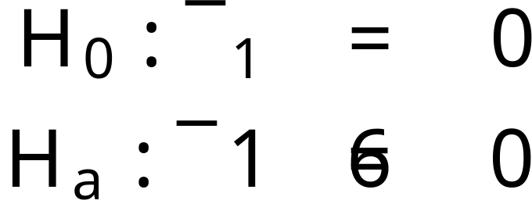

Inferences concerning ¯₁
Tests concerning ¯₁ (the slope) are often of interest, particularly
the null hypothesis model
implies that there is no relationship between Y and X

Slide 4
Review : Hypothesis Testing
Elements of a statistical test
  Null hypothesis, H₀
  Alternative hypothesis, H_{a}
  Test statistic
  Rejection region

Slide 5
Review : Hypothesis Testing - Errors
Errors
  A type I error is made if H₀ is rejected when H₀ is true. The probability of a type I error is denoted by ®. The value of ® is called the level of the test.
  A type II error is made if H₀ is accepted when H_{a} is true. The probability of a type II error is denoted by ¯.

Slide 6
P-value
The p-value, or attained significance level, is the smallest level of significance ® for which the observed data indicate that the null hypothesis should be rejected.

Slide 7
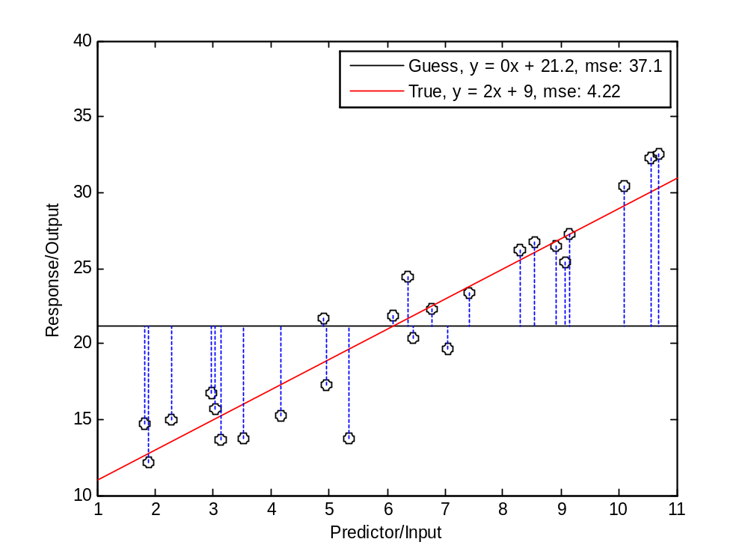
Null Hypothesis
If ¯₁ = 0 then with 95% confidence the b₁ would fall in some range around zero

Slide 8
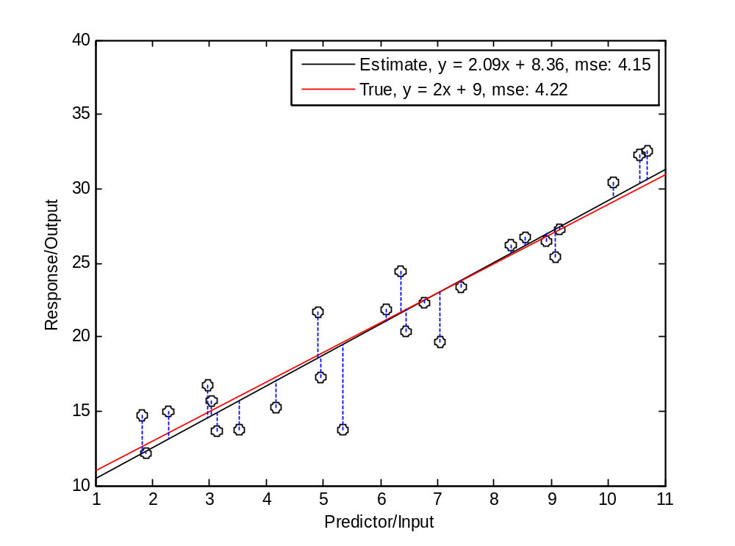
Alternative Hypothesis : Least Squares Fit
b₁ rescaled is
test statistic

Slide 9
Testing This Hypothesis
Only have a finite sample
Different finite set of samples (from the same population / source) will (almost always) produce different estimates of ¯₀ and ¯₁ (b₀, b₁) given the same estimation procedure
b₀ and b₁ are random variables whose sampling distributions can be statistically characterized
Hypothesis tests can be constructed using these distributions.

Slide 10
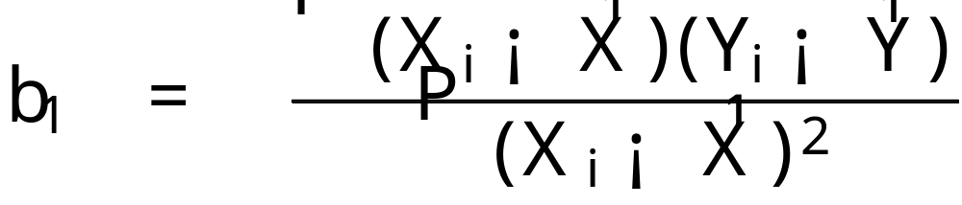
Example : Sampling Dist. Of b₁
The point estimator for b₁ is
The sampling distribution for b₁ is the distribution over b₁ that occurs when the predictor variables X_{i} are held fixed and the observed outputs are repeatedly sampled

Slide 11
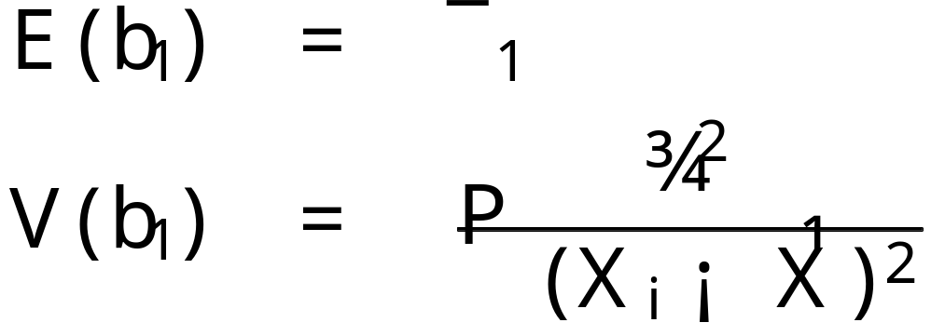
Sampling Dist. Of b₁ In Normal Regr. Model
For a normal error regression model the sampling distribution of b₁ is normal, with mean and variance given by
To show this we need to go through a number of algebraic steps.

Slide 12
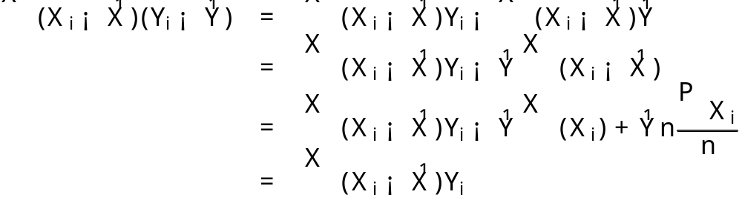
First step
To show
we observe

Slide 13
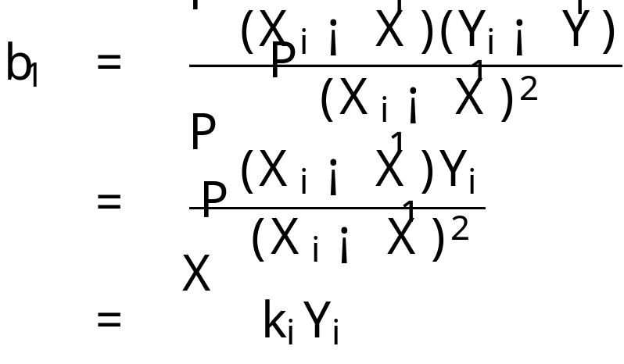
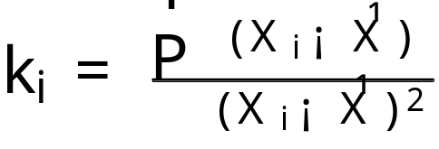
Slope as linear combination of outputs
b₁ can be expressed as a linear combination of the Y_{i}’s
where

Slide 14
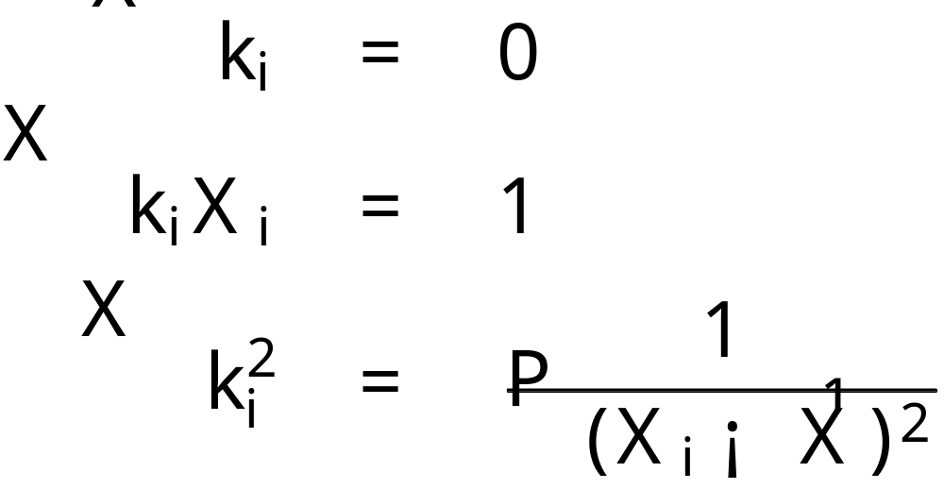
Properties of the k_{i}’s
It can be shown that
(possible homework). We will use these properties to prove various properties of the sampling distributions of b₁ and b₀.
write on board

Slide 15
Normality of b₁’s Sampling Distribution
Useful fact:
  A linear combination of independent normal random variables is normally distributed
  More formally: when Y₁, …, Y_{n} are independent normal random variables, the linear combination a₁Y₁ + a₂Y₂ + … + a_{n}Y_{n} is normally distributed, with mean ∑ a_{i}E(Y_{i}) and variance ∑ a²iV(Y_{i})

Slide 16
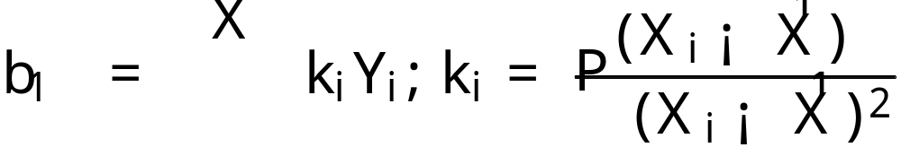
Normality of b₁’s Sampling Distribution
Since b₁ is a linear combination of the Y_{i}’s and each Y_{i} is an independent normal random variable, then b₁ is distributed normally as well
write on board

Slide 17
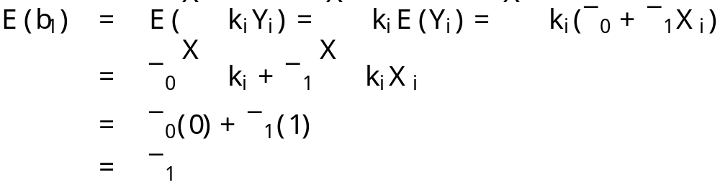
b₁ is an unbiased estimator
This can be seen using two of the properties

Slide 18
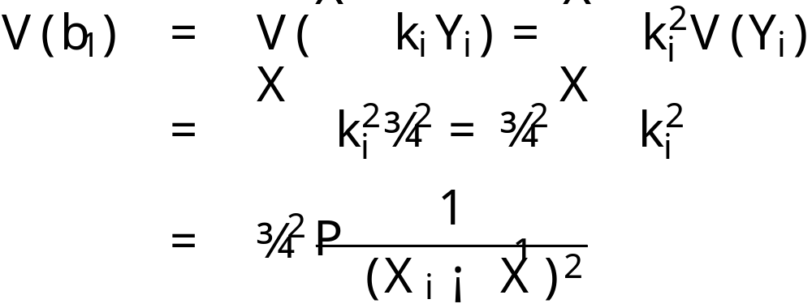
Variance of b₁
Since the Y_{i} are independent random variables with variance ¾² and the k_{i}’s are constants we get
note that this assumes that we know ¾².
  Can we?

Slide 19
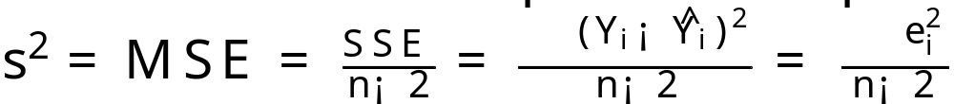
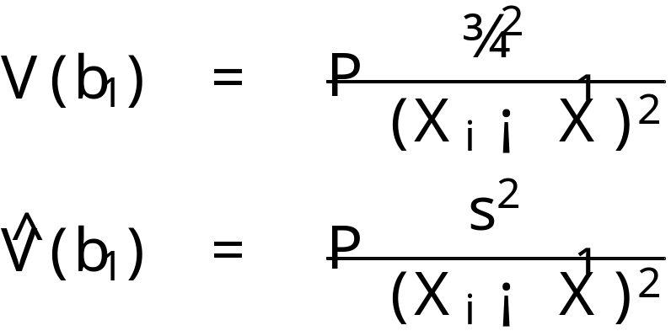
Estimated variance of b₁
When we don’t know ¾² then we have to replace it with the MSE estimate
Remember
plugging in we get

Slide 20
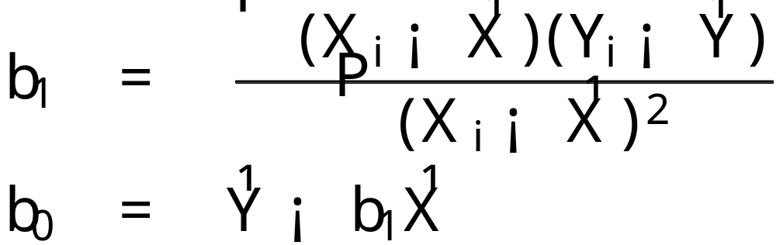
Digression : Gauss-Markov Theorem
In a regression model where E(²_{i}) = 0 and variance V(²_{i}) = ¾² < 1 and ²_{i} and ²_{j} are uncorrelated for all i and j the least squares estimators b₀ and b₁ and unbiased and have minimum variance among all unbiased linear estimators.
  Remember

Slide 21

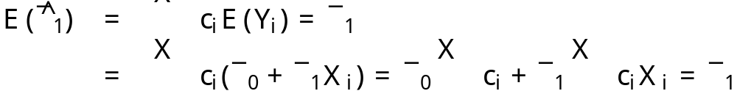
Proof
The theorem states that b₁ as minimum variance among all unbiased linear estimators of the form
As this estimator must be unbiased we have

Slide 22
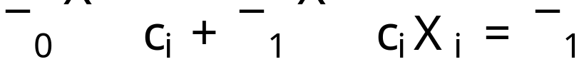
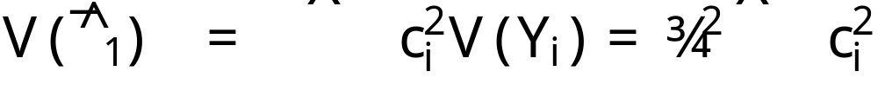
Proof cont.
Given these constraints
clearly it must be the case that ∑c_{i} =0 and ∑c_{i}X_{i} = 1
The variance of this estimator is
write these on board as conditions of unbiasedness

Slide 23
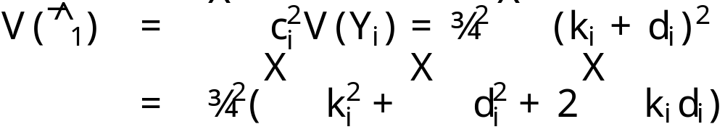
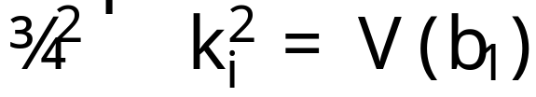
Proof cont.
Now define c_{i} = k_{i} + d_{i} where the k_{i} are the constants we already defined and the d_{i} are arbitrary constants. Let’s look at the variance of the estimator
Note we just demonstrated that

Slide 24
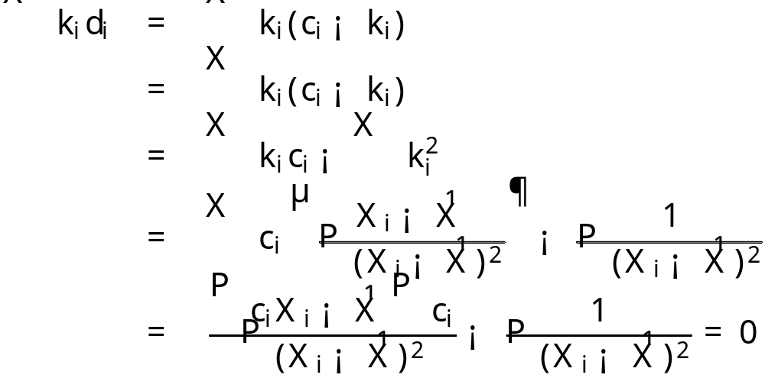
Proof cont.
Now by showing that ∑ k_{i} d_{i} = 0 we’re almost done
from conditions of unbiasedness

Slide 25
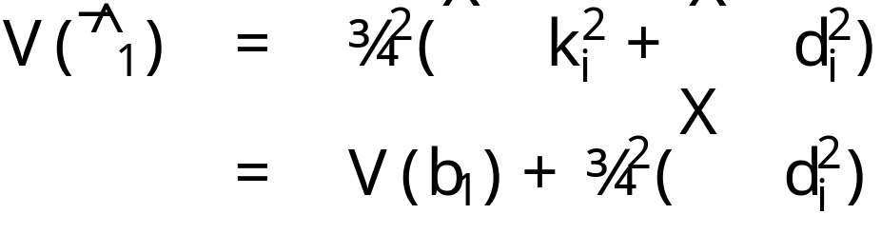
Proof end
So we are left with
which is minimized when the d_{i}’s = 0.
This means that the least squares estimator b₁ has minimum variance among all unbiased linear estimators.

Slide 26
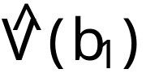
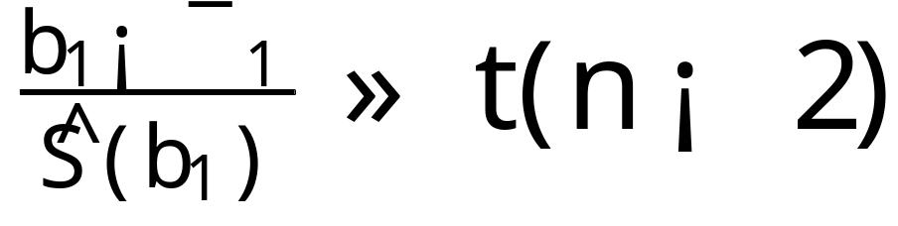
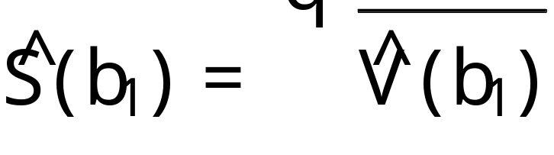
Sampling Distribution of (b₁ - ¯₁)/S(b₁)
b₁ is normally distributed so (b₁-¯₁)/(V(b₁)^{1/2}) is a standard normal variable
We don’t know V(b₁) so it must be estimated from data. We have already denoted it’s estimate
Using this estimate we it can be shown that

Slide 27
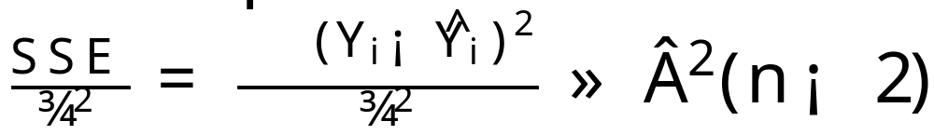
Where does this come from?
We need to rely upon the following theorem
  For the normal error regression model
  and is independent of b₀ and b₁
Intuitively this follows the standard result for the sum of squared normal random variables
  Here there are two linear constraints imposed by the regression parameter estimation that each reduce the number of degrees of freedom by one.

Slide 28
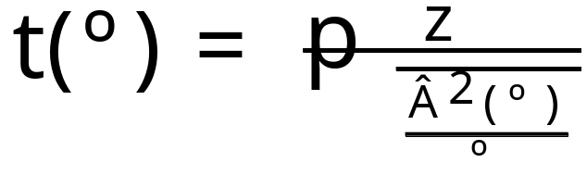
Another useful fact : t distribution
Let z and Â²(º) be independent random variables (standard normal and Â² respectively). We then define a t random variable as follows:
This version of the t distribution has one parameter, the degrees of freedom º

Slide 29
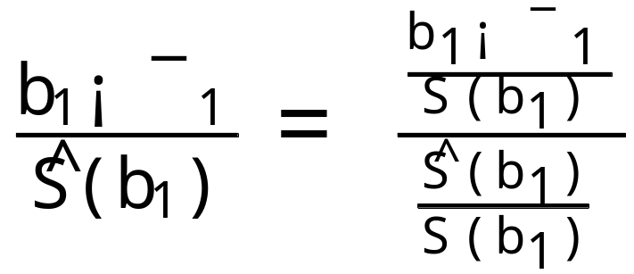
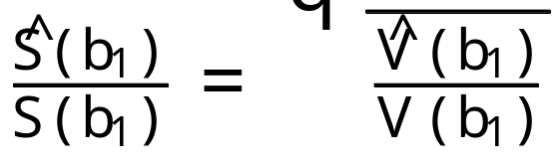
Distribution of the studentized statistic
To derive the distribution of this statistic, first we do the following rewrite
This is a standard
normal variable

Slide 30
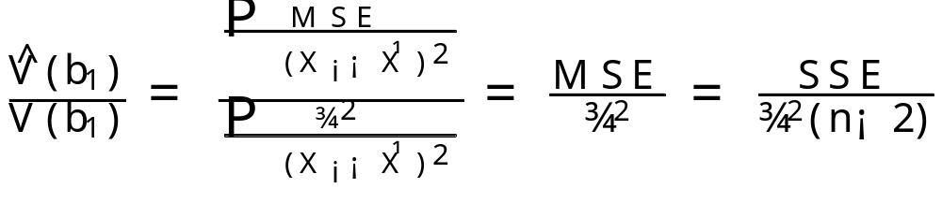
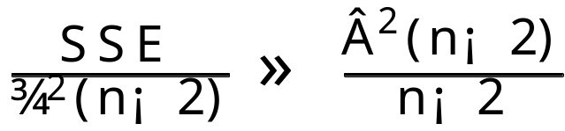
Studentized statistic cont.
And note the following
where we know (by the given theorem) the distribution of the last term is Â² and indep. of b₁ and b₀

Slide 31
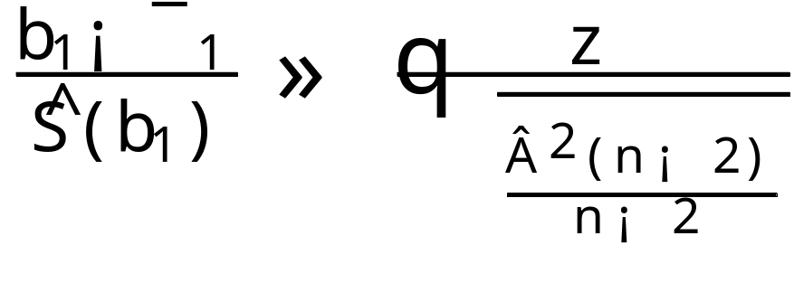
Studentized statistic final
But by the given definition of the t distribution we have our result
because putting everything together we can see that

Slide 32
Confidence Intervals and Hypothesis Tests
Now that we know the sampling distribution of b₁ (t with n-2 degrees of freedom) we can construct confidence intervals and hypothesis tests easily

